Slide 1
FindArt a social media website
Supervisor: Md. Abu Sayed
Name: Rosa Mahmud
ID:1730089
Summer 2021

Slide 2
Indtroduction
1

Slide 3
What is FindArt?
Helps you in finding the artist next door
A spotlight for underrated artists
Showcase your master piece

Slide 4
Hypothesis
To provide a platform for struggling artists to get work and for general public to find artists within their budget.

Slide 5
Tools and technologies used
2

Slide 6
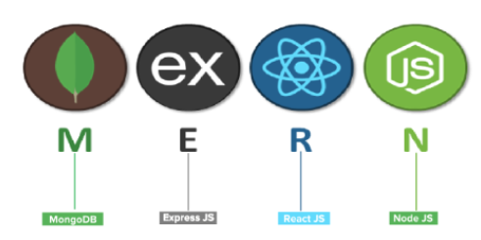
Technologies used
MongoDB
Express Js
React Js
Node Js
Material UI
.

Slide 7


Other technologies used

Slide 8
Literature Review
3

Slide 9
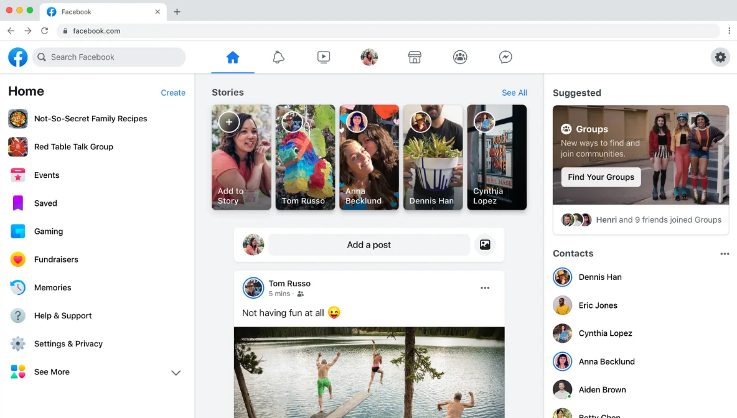
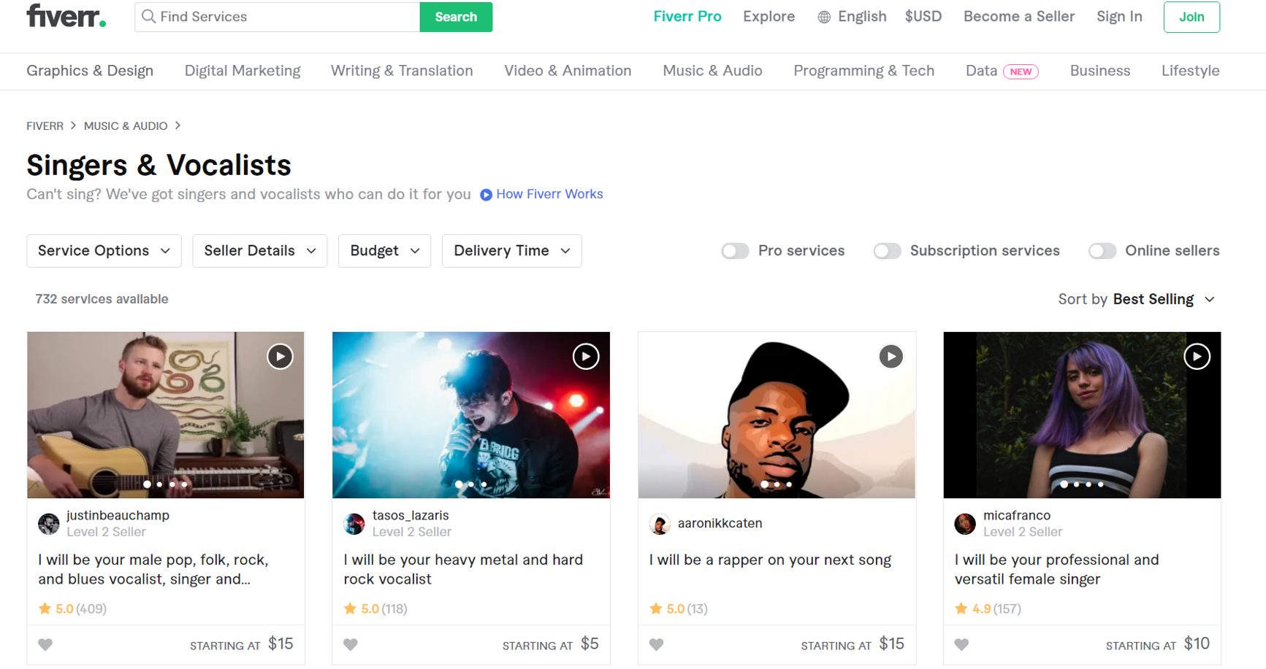
Similar work
Facebook Fiverr

Slide 10
Methodology
4

Slide 11
Extreme Programming
Simplicity maintained throughout development
Values:
Communication
Simplicity
Feedback
Courage
Respect

Slide 12
Discussion of data
5

Slide 13
Data used
Clients
Posts
Artists

Slide 14
Data analysis
6

Slide 15
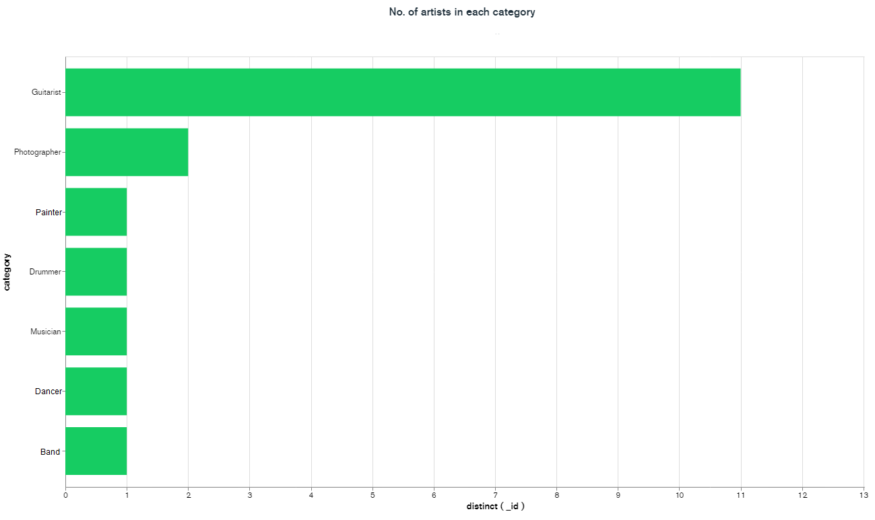
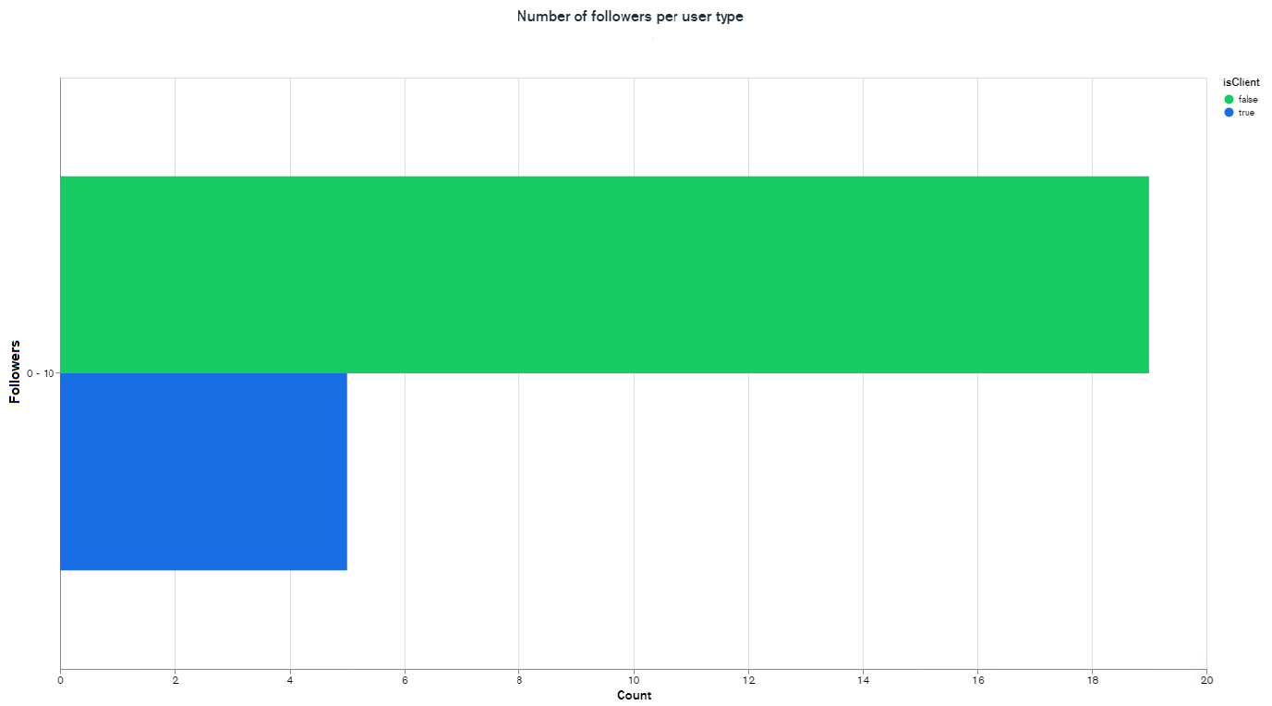
Statistical data representation

Slide 16
Conclusion
7

Slide 17
To summarize
Hands on experience in a professional environment
Improvement in interpersonal skills
Confidence to code
New skills

Slide 18
Future works
8

Slide 19
Things to implement
Mobile Application
Hosting Live Events
Booking System
Reminder System

Slide 20
Acknowledgement
9

Slide 21
I would like to thank
My family
My internal supervisor, Md. Abu Sayed
My external supervisor
My teachers
My mentors

Slide 22
Demo
10

Slide 23
THANK YOU
Any questions?

